Slide 1


Automating NGS Gene Panel Analysis Workflows
Gabe Rudy, VP of Product & Engineering
20 Most Promising Biotech
Technology Providers
Hype Cycle for Life sciences
Top 10 Analytics
Solution Providers

Slide 2


Slide 3
NIH Grant Funding Acknowledgments
Research reported in this publication was supported by the National Institute Of General Medical Sciences of the National Institutes of Health under:
    Award Number R43GM128485
    Award Number 2R44 GM125432-01
    Award Number 2R44 GM125432-02
    Montana SMIR/STTR Matching Funds Program Grant Agreement Number 19-51-RCSBIR-005
PI is Dr. Andreas Scherer, CEO Golden Helix.
The content is solely the responsibility of the authors and does not necessarily represent the official views of the National Institutes of Health.

Slide 4




Who Are We?
Golden Helix is a global bioinformatics company
founded in 1998
Filtering and Annotation
ACMG Guidelines
Clinical Reports
CNV Analysis
Pipeline: Run Workflows
Variant Warehouse
Centralized Annotations
Hosted Reports
Sharing and Integration
CNV Analysis
GWAS | Genomic Prediction
Large-N Population Studies
RNA-Seq
Large-N CNV-Analysis

Slide 5











Cited in 1,000s of Peer-Reviewed Publications

Slide 6















































Over 400 Customers Globally

Slide 7




When you choose Golden Helix, you receive more than just the software
SOFTWARE IS VETTED
DEEPLY ENGRAINED IN
SCIENTIFIC COMMUNITY
20,000+ users at 400+ organizations
Quality & feedback
Give back to the community
Contribute content and support
SIMPLE, SUBSCRIPTION-
BASED BUSINESS MODEL
INNOVATIVE SOFTWARE SOLUTIONS
Yearly licensing fee
Unlimited training & support
Cited in 1,000s of publications

Slide 8

Motivation for Automation
Reduce hands-on steps
Remove chance for human error
Increase throughput of the lab
Maximize the time spent by lab personnel on interpretation

Slide 9

Outline
Review NGS gene panel analysis process
Discuss strategies & guidelines to automate each step
Example automated pipeline demonstration

Slide 10
NGS Analysis Process
Raw Seq Data
FASTQ
BAM
Target Coverage
CNV Calling
CNV Interpret
Report
VCF
Variant Annotation
Filter & Rank
ACMG Scoring

Slide 11
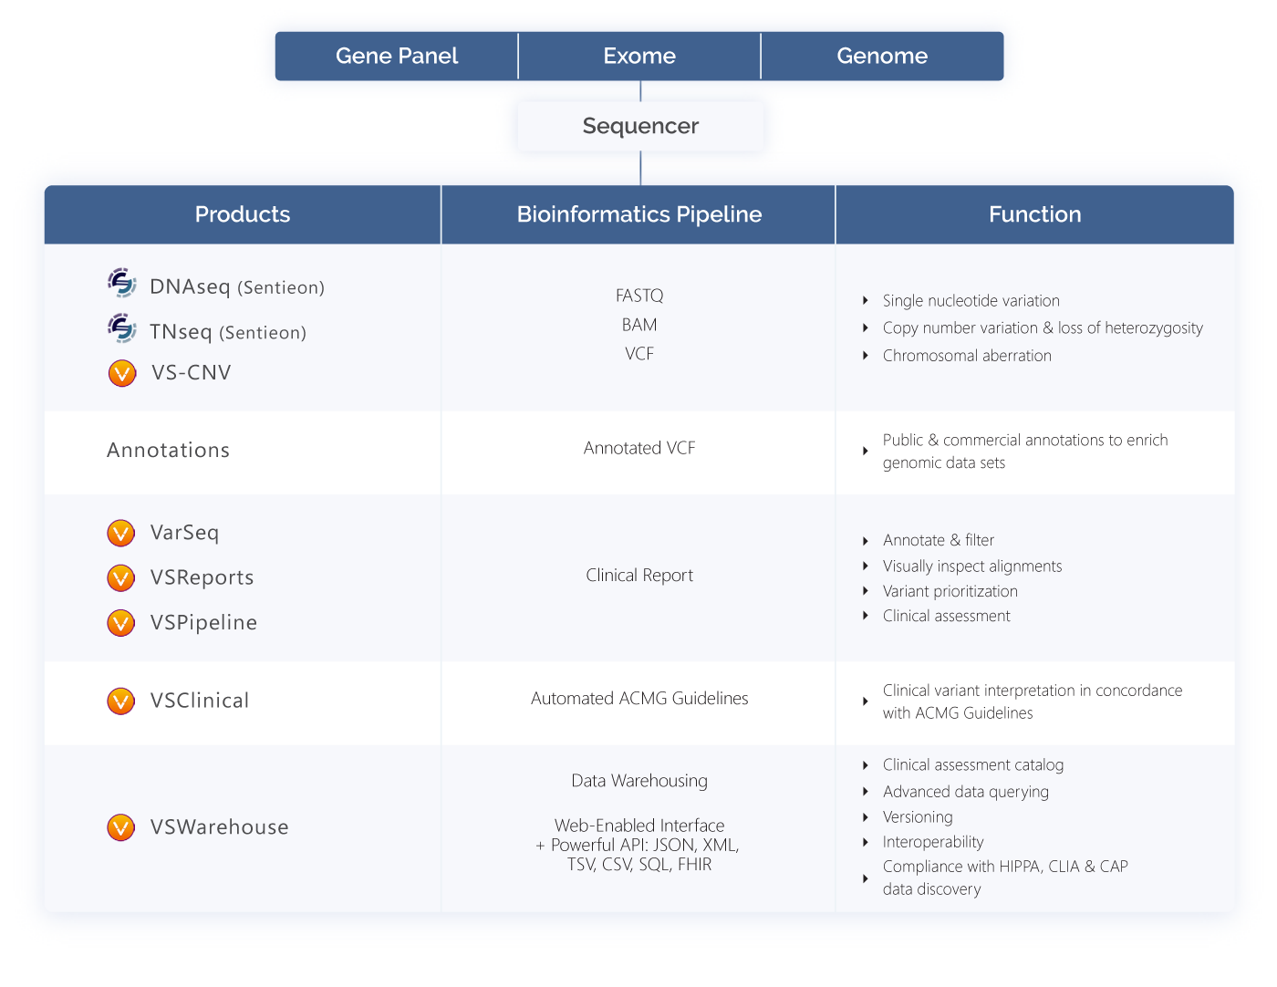

Slide 12








VarSeq Suite
Simple
Flexible
Scalable
Variant annotation
filtering, and interpretation
Powerful GUI with
rich visualizations
Repeatable
workflows

Slide 13
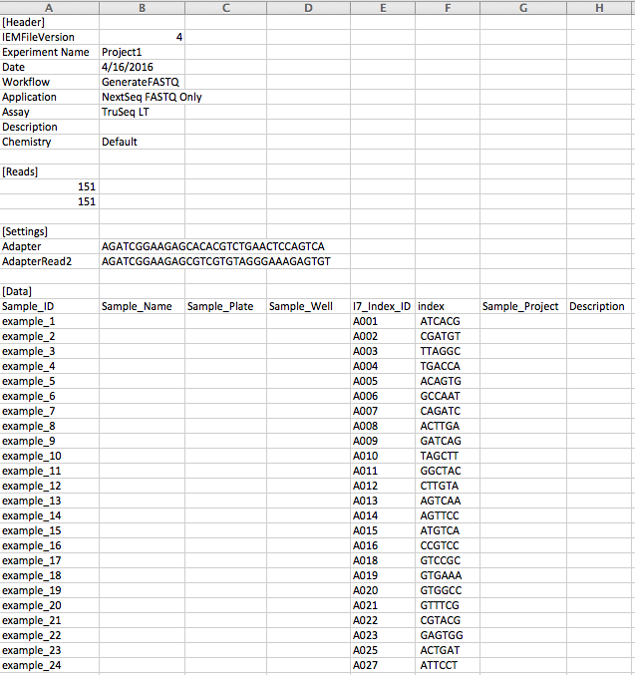
Raw Seq Data ➜ FASTQ
Convert raw image data to FASTQ
Demultiplexing: Using barcodes to split lanes into per-sample FASTQ files
Integrated Onboard MiniSeq and MiSeq
NovaSeq, HiSeq, NextSeq: “bcl2fastq”
Input:
  Run Output Folder (BCL Files)
  sample_sheet.csv or Manifest File
Output:
  One directory per sample, or one pair of FASTQ files per sample

Slide 14
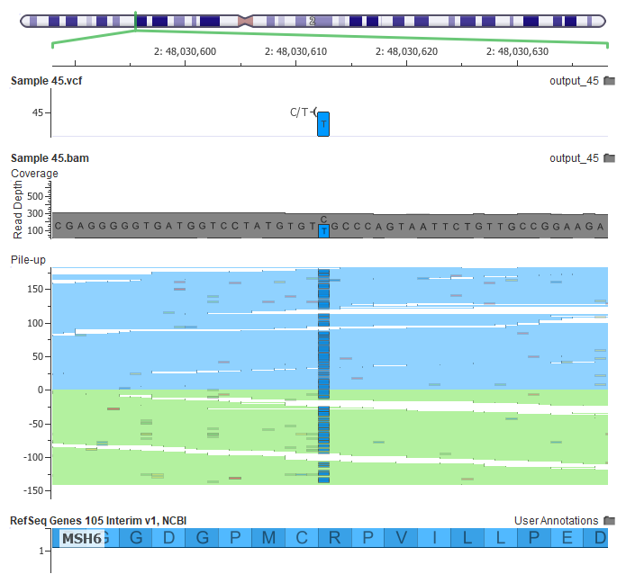
FASTQ ➜ BAM + VCF
Per-Sample Steps:
  Align with BWA-MEM, Sort
  Mark Duplicates
  Realign Insertions/Deletions
  Recalibrate Base Quality Scores
  Call Variants
Input:
  Per-Sample FASTQ
  Reference Sequence
  Known InDel Sights (for Realign)
  dbSNP (for Identifiers)
  Variant Caller Parameters
Output:
  Polished BAM
  Recalibration Plots
  Per-Sample VCF files

Slide 15
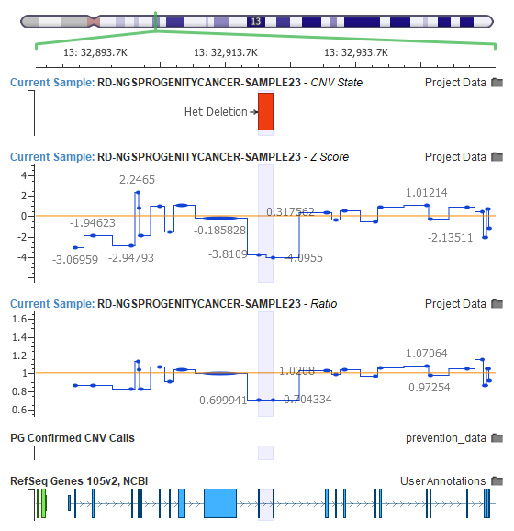
BAM ➜ Called CNVs
VS-CNV can call CNVs from NGS coverage
Normalizes coverage and compares to a pool of reference samples
Uses multiple metrics to make calls from single targets to whole chromosome aneuoploidy
Input:
  Target Regions
  CNV Reference Samples
Output:
  Per-Sample CNV Calls

Slide 16
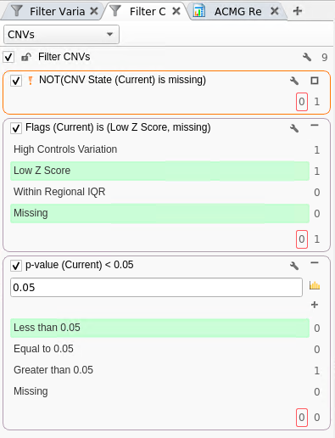
CNV Filtering and Analysis
Multiple QC metrics provided per CNV call
  Quality flags
  Average Z-Score / Ratios
  P-Value
Annotations help remove benign and highlight candidate clinical CNVs
Input:
  Raw CNV Calls
  Filtering Parameters
  CNV Annotations
Output:
  Annotated, High Quality Calls

Slide 17
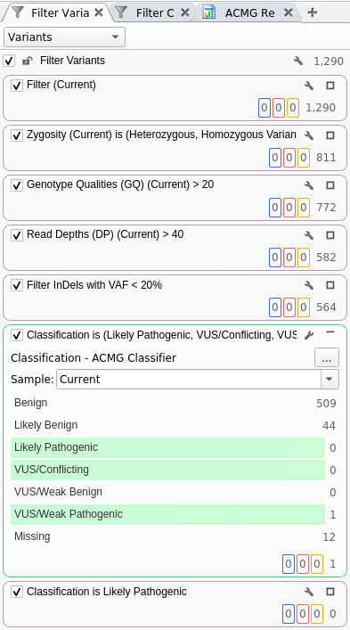
VCF ➜ Prioritized Variants
Quality metrics from variant caller provide utility for optimizing precision
Annotate public and proprietary annotation sources
Algorithms for scoring, prioritizing by phenotype
Input:
  Raw Variant Calls
  Filtering Parameters
  Variant Annotations
  Sample Phenotypes / Gene Lists
Output:
  Annotated Candidate Variants

Slide 18
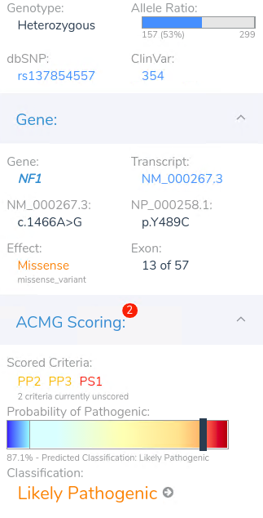
ACMG Scoring Variants
Candidate variants should be evaluated with appropriate guidelines
Previous interpretations incorporated
Workflow support for following guidelines accurately and efficiently
Partly automated, but ultimately requires hands on interpretation of novel variants
Input:
  Candidate variants
Output:
  Scored and interpreted variants ready for clinical reporting

Slide 19
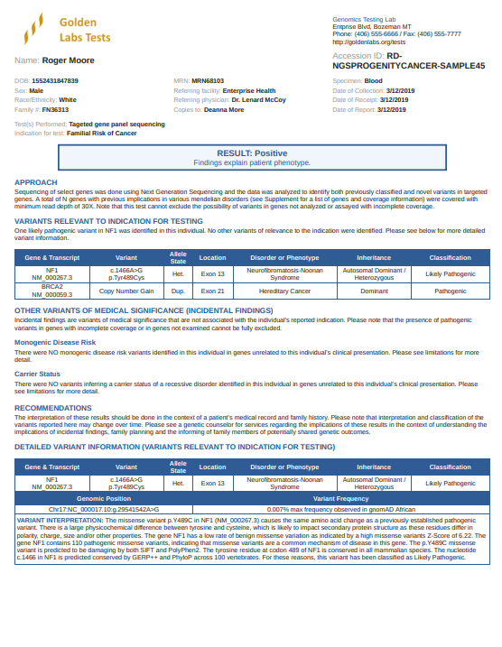
Clinical Report
Deliverable of the clinical genetic test
Lab and test specific report template that incorporates all relevant output
Manually reviewed and signed off by Lab Director
Input:
  Patient information
  Interpreted CNVs
  Interpreted Variants
Output:
  HTML, PDF or other structured data format

Slide 20

Automation Guidelines and Strategies
Use a script to chain together command line tools
Allow the script to take input parameters that may change
Have consistent naming and output structure
Logs as part of output structure
Precompute as much as possible, making the “jump in” point for analysis quick to open

Slide 21

Automation Demo
Starting Point:
  Per-sample FASTQ Files
  Samples.csv with patient information
File system watcher for samples.csv alongside a batch of FASTQ files
Kick off automation pipeline
Let’s start it and watch!

Slide 22

Automated Pipeline Components
Sentieon Secondary:
  Alignment with BWA-Mem
  Sort, Dedup, Realign, Recalibrate
  Call Variants
VarSeq (via VSPipeline)
  Create Project for Batch
  Steps defined by Project Template:
    VS-CNV Coverage & Call
    Annotate & Filter CNVs and Variants
    VSClinical ACMG Auto-Classifier
    VSReports Auto-Fill

Slide 23

Hand-On Steps
Outputs of Automation:
  BAM, Recalibration PDF, VCF files
  Excel Spreadsheet with variants + CNVs
  Draft HTML report
  Prepared project
Open project, review sample stats
Per Sample:
  QC and Interpret CNVs
  Interpret Candidate Variants
  Finalize Report
  Export as PDF

Slide 24
NIH Grant Funding Acknowledgments
Research reported in this publication was supported by the National Institute Of General Medical Sciences of the National Institutes of Health under:
    Award Number R43GM128485
    Award Number 2R44 GM125432-01
    Award Number 2R44 GM125432-02
    Montana SMIR/STTR Matching Funds Program Grant Agreement Number 19-51-RCSBIR-005
PI is Dr. Andreas Scherer, CEO Golden Helix.
The content is solely the responsibility of the authors and does not necessarily represent the official views of the National Institutes of Health.

Slide 26


GHI Updates
New eBook Release:
Clinical Variant Analysis – Applying the ACMG Guidelines to Analyze Germline Diseases
ACMG 2019 – Seattle, WA – April 2-6, 2019
Stop by the Golden Helix booth #622 for one of our live demos or one-on-one conversation

